Slide 1
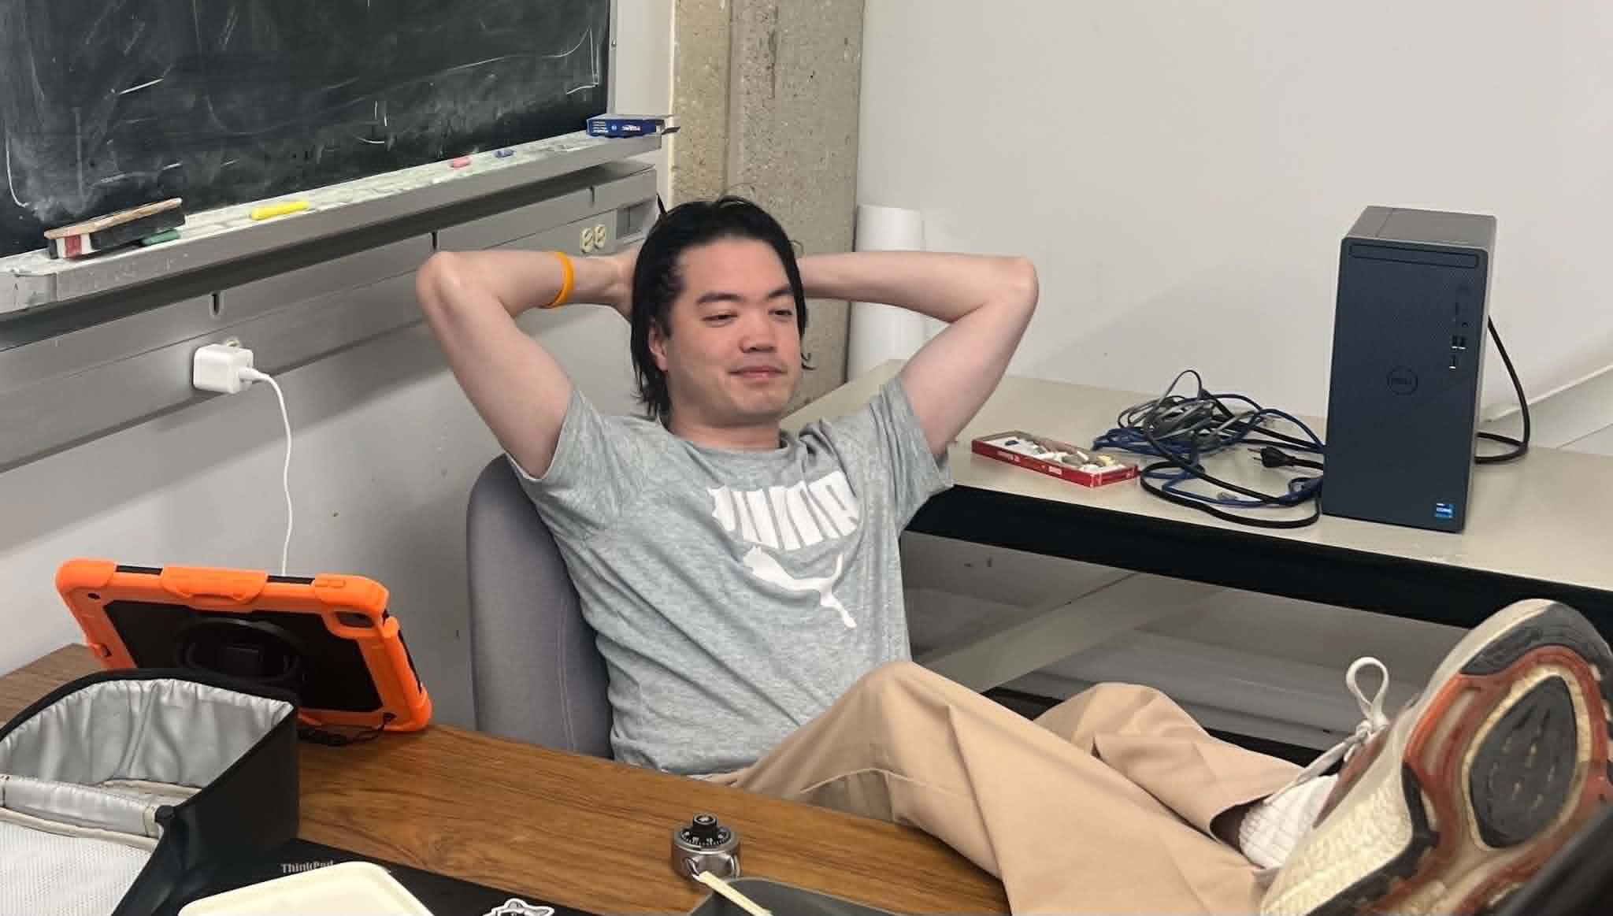
Introduction to ROS2
Author: Pi Thanacha Choopojcharoen
Presented by:
Ramisha Anjum

Slide 2
Agenda
ROS
ROS2
Nodes & Topics
Interfaces
Message
Services (*)
Actions (*)
Packages
Main Objective:
To read the RCLPY-based code, create and customize basic ROS2 node.
Photo credit: @bruce.digital
Notes:
This slide shows the roadmap for the session. We will start with ROS and ROS2 concepts, then move to nodes and topics, then messages and interfaces, and finally packages and basic RCLPY programming.
The main objective is practical: you should be able to read simple RCLPY-based code and create or customize a basic ROS2 node.
Tell students:
Do not worry if some terms sound unfamiliar now. We will keep coming back to the same core idea: ROS2 is about many small programs communicating with each other.

Slide 3
Motivation
Notes:
Start by asking: why do we need something like ROS2?
A robot is not usually controlled by one single program. A mobile robot may have a camera program, LiDAR program, localization algorithm, path planner, controller, motor driver, and visualization tool. Each part needs to exchange information with the others.
For example, a LiDAR node sends scan data, a localization node estimates where the robot is, a controller sends velocity commands, and the motor driver executes those commands.
ROS2 gives us a standard way to organize this communication.

Slide 4
Distributed Publish-Subscribe Middleware
Communication Channel
Node
Node
Node
Node
Notes:
This diagram introduces the communication idea. Each oval represents a node, which is a running software process. The center block represents the communication channel.
In robotics, we often do not want one huge program. Instead, we divide the system into smaller programs. Each program does one job and communicates with the others.
Example:
Camera node LiDAR node Localization node Controller node Motor driver node
Each one can run separately but still exchange data.

Slide 5
Distributed Publish-Subscribe Middleware
Publish
Communication Channel
Node
Node
Node
Node
Notes:
A node that sends data is called a publisher. For example:
Camera node publishes images. LiDAR node publishes scan data. Controller node publishes velocity commands.
Publishing means the node is sending data to a named communication channel. The publisher does not need to know exactly who is receiving the data.
This is one reason ROS2 is flexible. We can add or remove subscribers without rewriting the publisher.

Slide 6
Distributed Publish-Subscribe Middleware
Communication Channel
Node
Node
Node
Node
Notes:
Use this slide to reinforce that robot software is distributed. The communication channel sits between different nodes.
The important idea is that we separate computation into modules. One module may handle perception, another localization, another planning, and another control.
This makes the system easier to debug. If the controller is not working, we can inspect only the controller node and the topics it uses.

Slide 7
Distributed Publish-Subscribe Middleware
Subscribe
Communication Channel
Node
Node
Node
Node
Subscribe
Subscribe
Notes:
Now introduce the subscriber side.
A node that receives data is called a subscriber. For example:
Controller subscribes to robot pose. RViz subscribes to odometry. Motor driver subscribes to velocity command.
A useful analogy:
Topic = YouTube channel Publisher = person uploading videos Subscriber = person watching videos Message = the actual content
The publisher sends data. Any subscriber listening to the same topic receives it.

Slide 8

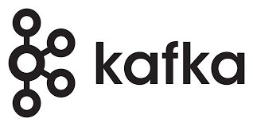

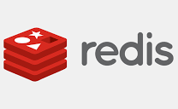


Distributed Publish-Subscribe Middleware
Communication Channel
Node
Node
Node
Node
Notes:
This is an important slide. Students may ask: if Kafka, Redis, MQTT, OPC UA, and ZeroMQ already exist, why do we use ROS2?
Explain clearly:
These tools are also communication middleware, but they are general-purpose communication tools. ROS2 is designed specifically for robotics.
Kafka is excellent for high-throughput data streaming, logging, and large distributed data pipelines. MQTT is lightweight and very common for IoT. Redis can be used for fast data exchange or caching. OPC UA is common in industrial automation. ZeroMQ is a flexible messaging library.
But robotics needs more than just sending messages.
Kafka, Redis, MQTT, OPC UA, and ZeroMQ are communication tools. ROS2 is a robotics framework built around communication, robot data types, coordinate frames, simulation, visualization, and robot software organization.
ROS2 does not replace all of these tools in every situation. For example, MQTT or Kafka may still be useful for cloud logging or fleet monitoring. But inside the robot, ROS2 is usually much more convenient because it understands robotics conventions.
General middleware = communication pipe ROS2 = robotics communication pipe + robot standards + robot tools + robot ecosystem

Slide 9
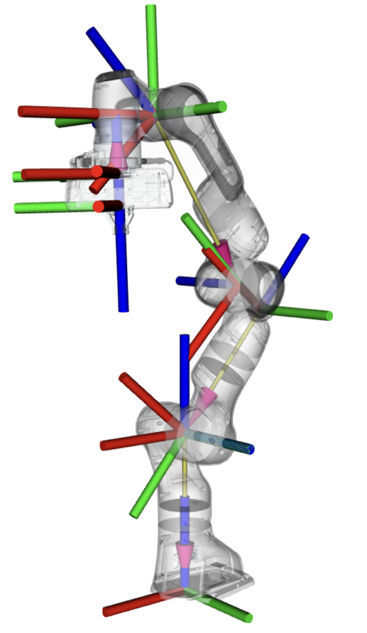
When should you use ROS ?
Communication Channel
Node
Node
Use ROS when building distributed robotic systems where sensors, actuators, and algorithms must exchange spatially referenced data and maintain consistent coordinate-frame transformations (e.g., perception, localization, kinematics).
Notes:
This slide answers when ROS is useful. Use ROS when building distributed robotic systems where sensors, actuators, and algorithms need to exchange data.
For mobile robots, this means:
Camera data LiDAR data IMU data Wheel odometry Robot pose Map data Velocity commands Coordinate-frame transformations
ROS is especially useful when data is spatially meaningful. For example, a LiDAR point is not just a number. It belongs to a coordinate frame. The robot must understand whether the data is in the LiDAR frame, robot base frame, map frame, or odometry frame.
This is why ROS is widely used in perception, localization, kinematics, mapping, and navigation.

Slide 10
Robot Operating System (ROS)

Slide 11
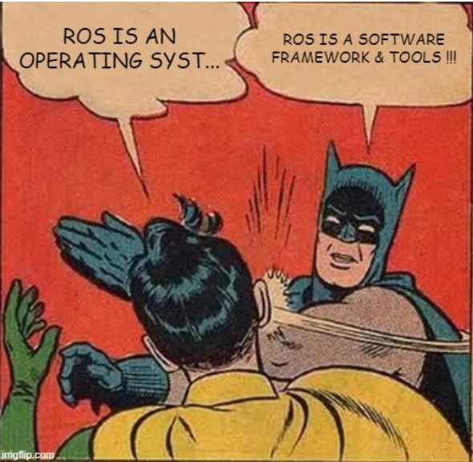
What is/isn’t ROS ?
Robot Operating System (ROS) was often mistaken as an operating system due to its misleading name.
ROS is a software framework for developing systems that consists of a cluster of computers.
It is often used with a robotics hardware that have operating systems.
Notes:
The name Robot Operating System is a little misleading.
Students may think ROS is like Windows, Ubuntu, or macOS. It is not. ROS is a framework that runs on top of an actual operating system, usually Linux/Ubuntu.
Emphasize this strongly:
ROS is not an operating system. ROS is a software framework and toolset.
A real operating system manages files, memory, hardware, processes, and users. ROS does not replace that.
Instead:
Ubuntu/Linux = actual operating system ROS2 = robotics framework running on top of Ubuntu/Linux
ROS helps developers build robot systems made of many software components.

Slide 12
What does ROS do ?
Tools, Standards, Conventions (REP)
Resource Sharing Platform
Notes:
ROS provides three main things.
First, tools: command-line tools, visualization tools, launch tools, debugging tools.
Second, standards and conventions: common message types, naming conventions, package structures, coordinate frame conventions.
Third, resource sharing: the ROS community provides packages that others can reuse.
This saves time. Instead of writing everything from zero, we can use existing packages and focus on the research or engineering problem.

Slide 13
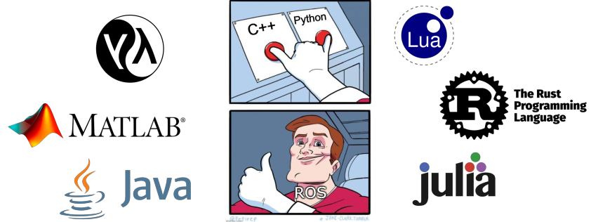
Supported Programming Language for ROS
Notes:
ROS supports multiple programming languages. The most common are Python and C++.
For this tutorial, we use Python because it is easier to read and good for learning.
But in real robotic systems:
Python = fast development, teaching, scripting, prototypes C++ = high-performance nodes, real-time control, heavy computation
Mention that ROS2 provides client libraries. For Python, the library is called:
rclpy
For C++, it is:
rclcpp

Slide 14
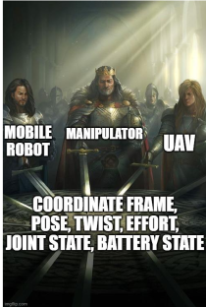
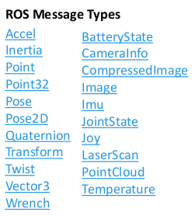
Common type of information used in robotics
Notes:
Robots do not only send simple numbers. They send structured information such as:
Pose = position and orientation Twist = linear and angular velocity Image = camera image LaserScan = LiDAR scan Imu = acceleration and angular velocity data JointState = joint positions and velocities PointCloud = 3D point data
ROS provides standard message definitions for these. This is important because different packages can communicate if they use the same message type.
For example, if a LiDAR driver publishes LaserScan, then mapping or navigation packages can subscribe to it without needing a custom converter.

Slide 15
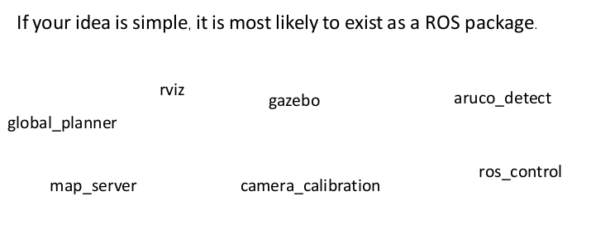
Packages for/by the ROS Community
Notes:
Examples:
rviz = visualization gazebo = simulation camera_calibration = camera calibration map_server = map loading and publishing global_planner = path planning ros_control = robot control framework aruco_detect = marker detection
Tell students:
If you are trying to do something common in robotics, there may already be a ROS package for it.
This does not mean the package will solve everything perfectly, but it gives a strong starting point.

Slide 16

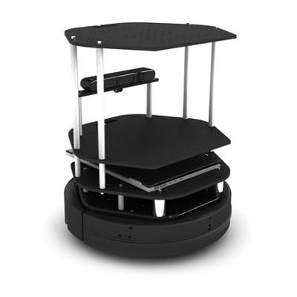
Physical System vs Simulation
For ROS2 Training with Pi
Algorithm = ????
Introduction to ROS2
Notes:
Now shift from ROS in general to how we test robot algorithms.
Ask students:
If we write a controller or planner, should we test it directly on a real robot first?
Usually, no. We first test in simulation.
The algorithm is the brain. It takes input data, such as pose or sensor readings, and produces outputs, such as velocity commands.
Simulation gives us a safer environment to test the algorithm before using real hardware.

Slide 17
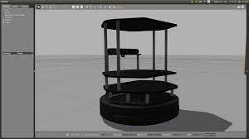
For ROS2 Training with Pi
Physical System vs Simulation
Simulation-in-the-loop Test
Algorithm
model
Introduction to ROS2
Notes:
This slide introduces simulation-in-the-loop.
The algorithm communicates with a model of the robot instead of the physical robot. The simulator provides sensor-like data, and the algorithm sends control commands back.
Example:
Simulator publishes robot pose. Controller subscribes to pose. Controller publishes velocity command. Simulator receives velocity command and moves the robot.
This is exactly the same communication idea we will use later with turtlesim.

Slide 18
Physical System vs Simulation
For ROS2 Training with Pi
Tuning
Algorithm
Model
Introduction to ROS2
Getting to know ROS
Notes:
The model represents the robot and environment inside the computer. It may include robot geometry, dynamics, sensor behavior, and world obstacles.
Tuning means adjusting controller gains or algorithm parameters.
For example, if a robot turns too slowly, we may increase an angular gain. If it oscillates, we may reduce a gain.
Simulation lets us tune safely before testing on hardware.

Slide 19
Physical System vs Simulation
For ROS2 Training with Pi
Tuning with the simulation
Algorithm
model
Introduction to ROS2
Notes:
In simulation, we can repeatedly test the algorithm with different parameters.
For example:
Try controller gain = 1 Try controller gain = 2 Try controller gain = 5 Observe motion Choose stable behavior
This is useful because mistakes in simulation do not damage the real robot.
But also remind students that simulation is not perfect. Real robots have friction, sensor noise, delays, motor limits, and calibration errors.

Slide 20
Physical System vs Simulation
For ROS2 Training with Pi
A robot needs a computer.
Algorithm
So does the simulation.
Introduction to ROS2
Notes:
This slide makes an important point: both real robots and simulations require computing resources.
A real robot may use a Raspberry Pi, Jetson, laptop, or onboard computer. A simulation also needs a computer to compute the physics, graphics, and sensors.
For simple demos like turtlesim, any normal computer is enough. For Gazebo simulation with 3D sensors, we need more CPU/GPU power.

Slide 21
Physical System vs Simulation
For ROS2 Training with Pi
A robot needs a computer.
Algorithm
So does the simulation.
Q1.) Should they use the same computer ?
Introduction to ROS2
Notes:
Ask students this question before answering.
The answer is: sometimes yes, sometimes no.
For learning, we often run everything on one computer. For real systems, the robot may have an onboard computer, while visualization and monitoring run on a laptop.
ROS2 supports both:
single-computer setup multi-computer setup
This is one of the reasons ROS2 is useful for distributed robot systems.

Slide 22
Physical System vs Simulation
For ROS2 Training with Pi
A robot needs a computer.
Algorithm
So does the simulation.
Q2.) Which one should be more powerful ?
Introduction to ROS2
Notes:
which needs more computing power, the real robot computer or the simulation computer?
Usually, simulation can be more computationally demanding, especially if it includes 3D graphics, physics, cameras, LiDAR, and multiple robots.
A real robot computer may only run selected onboard algorithms. But simulation may need to compute the robot, environment, sensors, and visualization at the same time.
So for this tutorial, we use turtlesim because it is lightweight and good for learning.

Slide 23
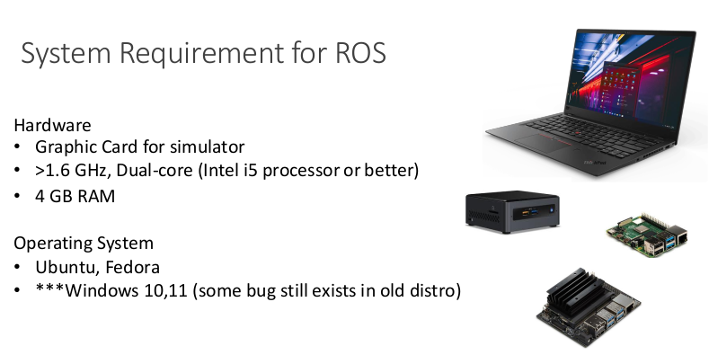
Notes:
Now that we understand why robot software needs communication, simulation, and reusable tools, we move specifically to ROS2.
ROS2 is the modern version of ROS designed to handle distributed systems better than ROS1.

Slide 24
ROS2

Slide 25
Issues from using ROS(1)
ROS was not designed to support a system of multiple robots due to its used of a single master node.
The paradigm of communication was not design to support real time operation,
ROS was designed so that the resources should be loca (contains within the computer) for optimal performance.
ROS was essentially a centralized system, which is not designed to support multi-agent system.
Notes:
ROS1 worked very well for research and prototyping, but it had limitations.
The most important one is the central master. ROS1 uses a master node to help nodes find each other. If the master has problems, communication can be affected.
ROS1 was also not originally designed for large multi-robot systems or strict real-time operation.
So ROS1 was excellent for many applications, but robotics needs grew beyond the original design.

Slide 26

ROS2
Utilize Data Distribution instead of TCPROS
No Central Master.
Real-time Capability (deterministic execution, executor-based scheduling)
Notes:
ROS2 improves the communication architecture.
Key points:
ROS2 uses DDS-based communication. ROS2 has no central ROS master. ROS2 is better for distributed systems. ROS2 supports more real-time-aware execution.
Explain DDS at a high level only:
DDS is a communication standard for distributed systems. ROS2 uses DDS underneath so that nodes can discover each other and exchange data without a central ROS master.
Also connect to ME640:
For autonomous mobile robots, this is useful because sensors, controllers, visualization, and hardware may run on different computers.

Slide 27
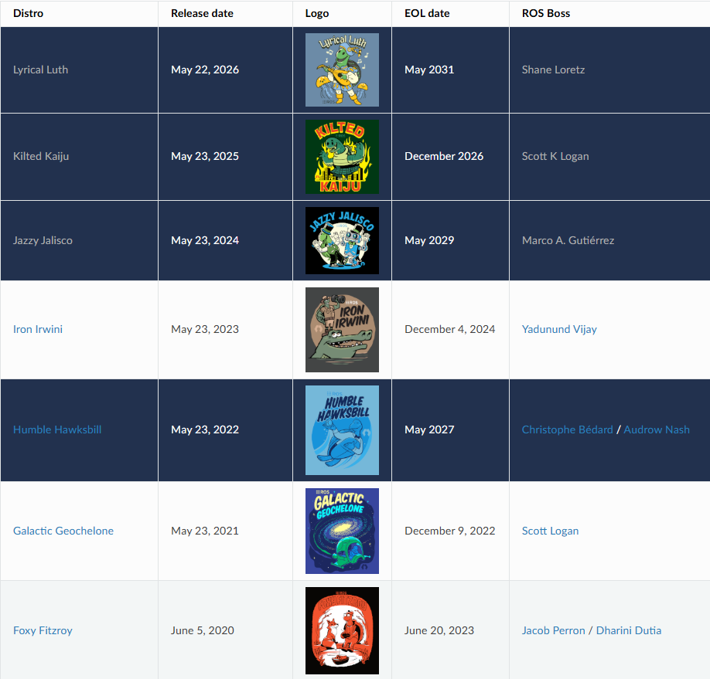
Distribution (Distro)
The LTS distro is released in even number years (i.e. 2022,2024, 2026,...)
Notes:
A ROS2 distribution, or distro, is a specific version of ROS2.
Examples include:
Humble Iron Jazzy Kilted
LTS means Long-Term Support. LTS versions are usually preferred for courses and projects because they are supported longer.
Useful command:
echo $ROS_DISTRO
This tells students which ROS2 distro they are using.
Mention that if the slide shows Humble but the environment uses Jazzy, the commands are mostly similar, but installation package names may change.

Slide 28
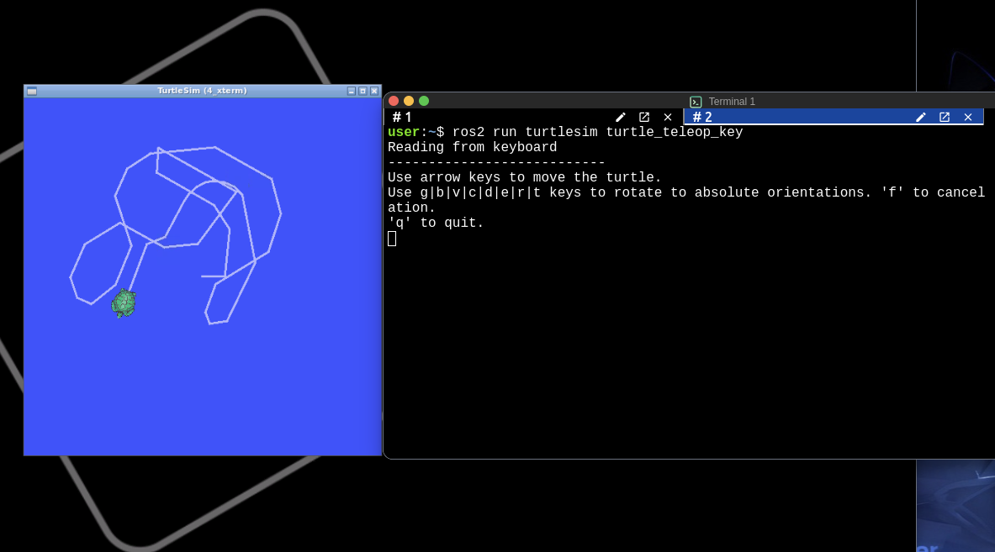
The Construct (Emulating ROS2 environment)
Go to https://app.theconstruct.ai/
Register a new free account or log in with your Google account
Click on “My Rosjects” folder then “Create a New Rosject”
Name your Rosject, select the desired Distro (Jazzy), and select blank simulation
In the first terminal, run this command
In a new terminal , run this command
ros2 run turtlesim turtlesim_node
ros2 run turtlesim turtle_teleop_key

Slide 29
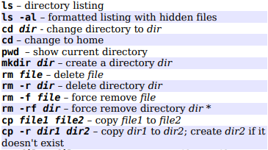
Ubuntu : Common Command
For ROS2 Training with Pi
List all installed ROS package
>> apt list ros-humble* --installed
Install a ROS package
>> sudo apt install ros-humble-[PACKAGE]
Open file explorer from the current working direcrtory
>> nautilus .
Modify bashrc
>> code ~/.bashrc
Navigating Linux Terminal

Slide 30
Nodes & Topics

Slide 31
The concept of Nodes and Topics
/node_name
process
/topic_name
communication channel
Node can have a publisher that publish a message to a topic.
Node can also have a subscription that subscribe a message from a topic.
Notes:
Explain:
Node = running process Topic = communication channel Publisher = sends messages Subscriber = receives messages
Example:
/turtlesim is a node. /turtle1/cmd_vel is a topic. /turtle1/pose is a topic.
A node can publish to one topic and subscribe to another topic at the same time.
In robotics terms:
Sensor node publishes sensor data. Controller node subscribes to sensor data. Controller node publishes motor commands. Motor node subscribes to motor commands.

Slide 32
The concept of Nodes and Topics
For ROS2 Training with Pi
NODE
process
TOPIC
Communication Channel
Q1.) Can a node have both a publisher and a subscription to the same topic ?
Q2.) Should a node have both a publisher and a subscription to the same topic ?
Introduction to ROS2
Notes:
Use this as an interactive slide.
Question 1:
Can a node have both a publisher and a subscription?
Answer: yes.
Example: a controller node subscribes to pose and publishes velocity.
Question 2:
Should a node publish and subscribe to the same topic?
Usually, no. It can create confusing loops. A node can technically do it, but unless there is a special reason, it is better to keep input and output topics separate.
Example of good design:
Input: /turtle1/pose Output: /turtle1/cmd_vel

Slide 33
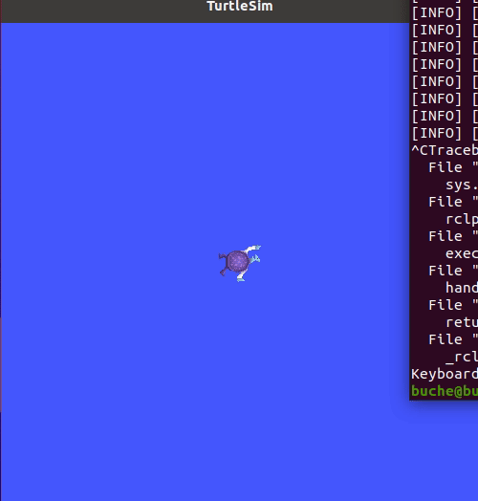
Example: Turtlesim Simulation
Command lines for nodes:
/turtle1/pose
ros2 run [package_name] [executable]
ros2 node list
ros2 node info [node_name] –verbose
ros2 topic list
/turtlesim
P
S
/turtle1/cmd_vel
ros2 run turtlesim turtlesim_node
Notes:
Introduce turtlesim.
Turtlesim is a simple 2D simulator used for learning ROS2 concepts. It is not meant to be a realistic robot simulator. It is useful because it clearly shows topics, nodes, and messages.
Live commands:
Terminal 1:
ros2 run turtlesim turtlesim_node
Terminal 2:
ros2 node list
Expected:
/turtlesim
Then:
ros2 topic list
Point out:
/turtle1/pose /turtle1/cmd_vel
Explain:
/turtle1/pose = turtle publishes current state /turtle1/cmd_vel = turtle receives velocity commands

Slide 34

Example: Turtlesim Simulation +Teleoperation
/turtle1/pose
/turtlesim
/turtle_teleop
P
S
P
/turtle1/cmd_vel
ros2 run turtlesim turtlesim_node
ros2 run turtlesim turtle_teleop_key
Notes:
Now add a keyboard control node.
Terminal 2:
ros2 run turtlesim turtle_teleop_key
Keep this terminal active and press arrow keys.
Explain the communication:
/turtle_teleop publishes velocity command. /turtlesim subscribes to velocity command. The topic is /turtle1/cmd_vel.
Then inspect:
ros2 node list ros2 topic list
This shows students that running a new program adds a new node to the ROS2 network.

Slide 35
Example: Turtlesim Simulation +Feedback Control
/turtle1/pose
/turtle1/goal
/turtlesim
/go_to_goal
P
S
S
S
P
/turtle1/cmd_vel
ros2 run turtlesim turtlesim_node
ros2 run turtlesim_control go_to_goal.py
Notes:
This slide introduces the controller idea.
Teleoperation means a human sends commands. Feedback control means a node automatically computes commands based on the turtle’s current pose and goal.
The controller node:
subscribes to /turtle1/pose subscribes to /turtle1/goal publishes to /turtle1/cmd_vel
Explain the control logic simply:
current position → compare with goal → compute velocity command → turtle moves
This is the foundation of autonomous mobile robot control.

Slide 36
Message Type
geometry_msgs/msg/Point
/turtle1/pose
/turtle1/goal
turtlesim/msg/Pose
/turtlesim
/go_to_goal
The type of a message being published by a publisher must be the same as the one being subscribed by a subscriber.
/turtle1/cmd_vel
geometry_msgs/msg/Twist
A topic must be consistent throughout the network. Its type can be based on a message type from an existing package or a custom message type.
Notes:
A topic is not just a name. It also has a data type.
For example:
/turtle1/pose uses turtlesim/msg/Pose /turtle1/cmd_vel uses geometry_msgs/msg/Twist /turtle1/goal uses geometry_msgs/msg/Point
The publisher and subscriber must use the same message type.
Analogy:
If one person sends a picture, the receiver must expect a picture. If one node publishes a velocity command, the subscriber must expect a velocity command.
This prevents confusion in the ROS2 network.

Slide 37
Message Type
cmd_vel: geometry_msgs/msg/Twist:
linear: geometry_msgs/msg/Vector3
x : float
y: float
z: float
angular: geometry_msgs/msg/Vector3
x : float
y: float
z: float
Command lines for topics:
ros2 topic echo [topic name]
ros2 topic info [topic name]
ros2 topic pub -r [rate] [message type] [topic_name] [message info]
Notes:
Explain Twist.
A Twist message represents velocity:
linear velocity angular velocity
For a 2D mobile robot, usually:
linear.x = forward speed angular.z = turning speed
Live commands:
ros2 topic info /turtle1/cmd_vel ros2 interface show geometry_msgs/msg/Twist
Then publish velocity:
ros2 topic pub -r 10 /turtle1/cmd_vel geometry_msgs/msg/Twist "{linear: {x: 2.0}, angular: {z: 1.5}}"
The turtle should move in a circle.

Slide 38
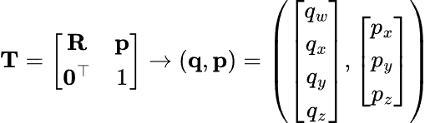
Example Message: Pose
pose: geometry_msgs/msg/Pose:
orientation: geometry_msgs/msg/Quaternion
x : float
y: float
z: float
w: float
position: geometry_msgs/msg/Vector3
x : float
y: float
z: float
Notes:
Explain pose.
A pose means:
position + orientation
In 3D robotics, position has:
x, y, z
Orientation is often represented using a quaternion:
x, y, z, w
For today, students do not need to deeply understand quaternions. Just say:
A quaternion is a standard way to represent 3D orientation without some problems that occur with Euler angles.
For turtlesim, the pose is simpler and includes x, y, and theta.

Slide 39
The concept of message
For ROS2 Training with Pi
turtlesim/msg/Pose
ros2 topic echo [topic_name] ros2 topic info [topic_name] ros2 interface show [message_type]
/turtle1/pose
/turtlesim
Twist :
linear:
x
y
z
angular:
x
y
z
Type of message
/turtle1/cmd_vel
geometry_msgs/msg/Twist
ros2 run turtlesim turtlesim_node
Introduction to ROS2
Notes:
This slide reinforces topic inspection.
Commands:
ros2 topic echo /turtle1/pose
shows messages being published.
ros2 topic info /turtle1/pose
shows the message type and publisher/subscriber count.
ros2 interface show turtlesim/msg/Pose
shows the structure of the message.
Mention the correction:
turtlesim/msg/Pose geometry_msgs/msg/Twist
Use these corrected forms.

Slide 40
Publising messages from the terminal
For ROS2 Training with Pi
/turtle1/pose
/turtlesim
ros2 topic pub –r [rate in Hz] [topic_name] [message_type] “[data]"
/turtle1/cmd_vel
YAML format
ros2 topic pub –r 10 /turtle1/cmd_vel geometry_msgs/msg/Twist {linear: {x: 2.0, y: 0.0, z: 0.0}, angular: {x: 0.0, y: 0.0, z: 1.8}}
Introduction to ROS2
Notes:
Explain that ROS2 lets us publish messages directly from the terminal. This is very useful for testing.
Command:
ros2 topic pub -r 10 /turtle1/cmd_vel geometry_msgs/msg/Twist "{linear: {x: 2.0, y: 0.0, z: 0.0}, angular: {x: 0.0, y: 0.0, z: 1.8}}"
Explain:
-r 10 means publish at 10 Hz. linear.x = 2.0 means move forward. angular.z = 1.8 means rotate.
This makes the turtle move in a circle.
Also tell students that the message is written in YAML-like format.

Slide 41
The concept of service
For ROS2 Training with Pi
ros2 service list ros2 service info [service_name] ros2 interface show [service_type] ros2 service call [service_name] [service_type] [request_data]
1-1 communication
Suitable for more private communication that happens once in a while
Node can have a service server that provides service to a service client from other nodes.
Introduction to ROS2
Notes:
A topic is for continuous streaming. A service is for request-response communication.
Say:
Topic = continuous data flow Service = ask once, receive one response
Examples:
Spawn a new turtle Clear the screen Reset the simulator
Live demo:
ros2 service list ros2 service type /spawn ros2 interface show turtlesim/srv/Spawn ros2 service call /spawn turtlesim/srv/Spawn "{x: 2.0, y: 2.0, theta: 0.0, name: 'turtle2'}"
Explain that /spawn is not continuous; we call it once when we want a new turtle.

Slide 42
The concept of ROS2 Parameter
For ROS2 Training with Pi
ros2 param list ros2 param get [node_name] [parameter_name] ros2 param set [node_name] [parameter_name] [value] ros2 param dump [node_name] ros2 param load [node_name] [parameter_file] ros2 run [package_name] [executable] --ros-args –params-file [file_name]
/turtlesim
[background_g=86]
Parameter is a constant that is associated with that particular node. It can be modified and accessed by terminal interface.
Introduction to ROS2
Notes:
A parameter is a configurable value associated with a node.
For example, turtlesim has background color parameters.
Live demo:
ros2 param list ros2 param get /turtlesim background_g ros2 param set /turtlesim background_r 0 ros2 param set /turtlesim background_g 0 ros2 param set /turtlesim background_b 0 ros2 service call /clear std_srvs/srv/Empty "{}"
Explain:
We changed the parameter values, then called /clear so the background updated.
Parameters are useful because we can tune a node without changing the source code.

Slide 43
The concept of action
For ROS2 Training with Pi
ros2 action list ros2 action info [action_name] ros2 interface show [action_type] ros2 action send_goal [action_name] [action_type] [value] -f
1-1 communication
Suitable for task that requires time to complete such as planning, optimizing, navigating, etc.
A node can have an action server that execute an "action", then return the result to the client.
Introduction to ROS2
Notes:
Actions are for tasks that take time.
A service is quick request-response. An action is better when the task may take several seconds or minutes and we want feedback.
Examples:
Navigate to a goal Follow a path Rotate to a target angle Pick up an object Plan a trajectory
Turtlesim action demo:
ros2 action list ros2 action info /turtle1/rotate_absolute ros2 interface show turtlesim/action/RotateAbsolute ros2 action send_goal /turtle1/rotate_absolute turtlesim/action/RotateAbsolute "{theta: 1.57}" --feedback
Explain:
The action sends a goal, the turtle performs the rotation, and ROS2 can provide feedback while the task is running.

Slide 44
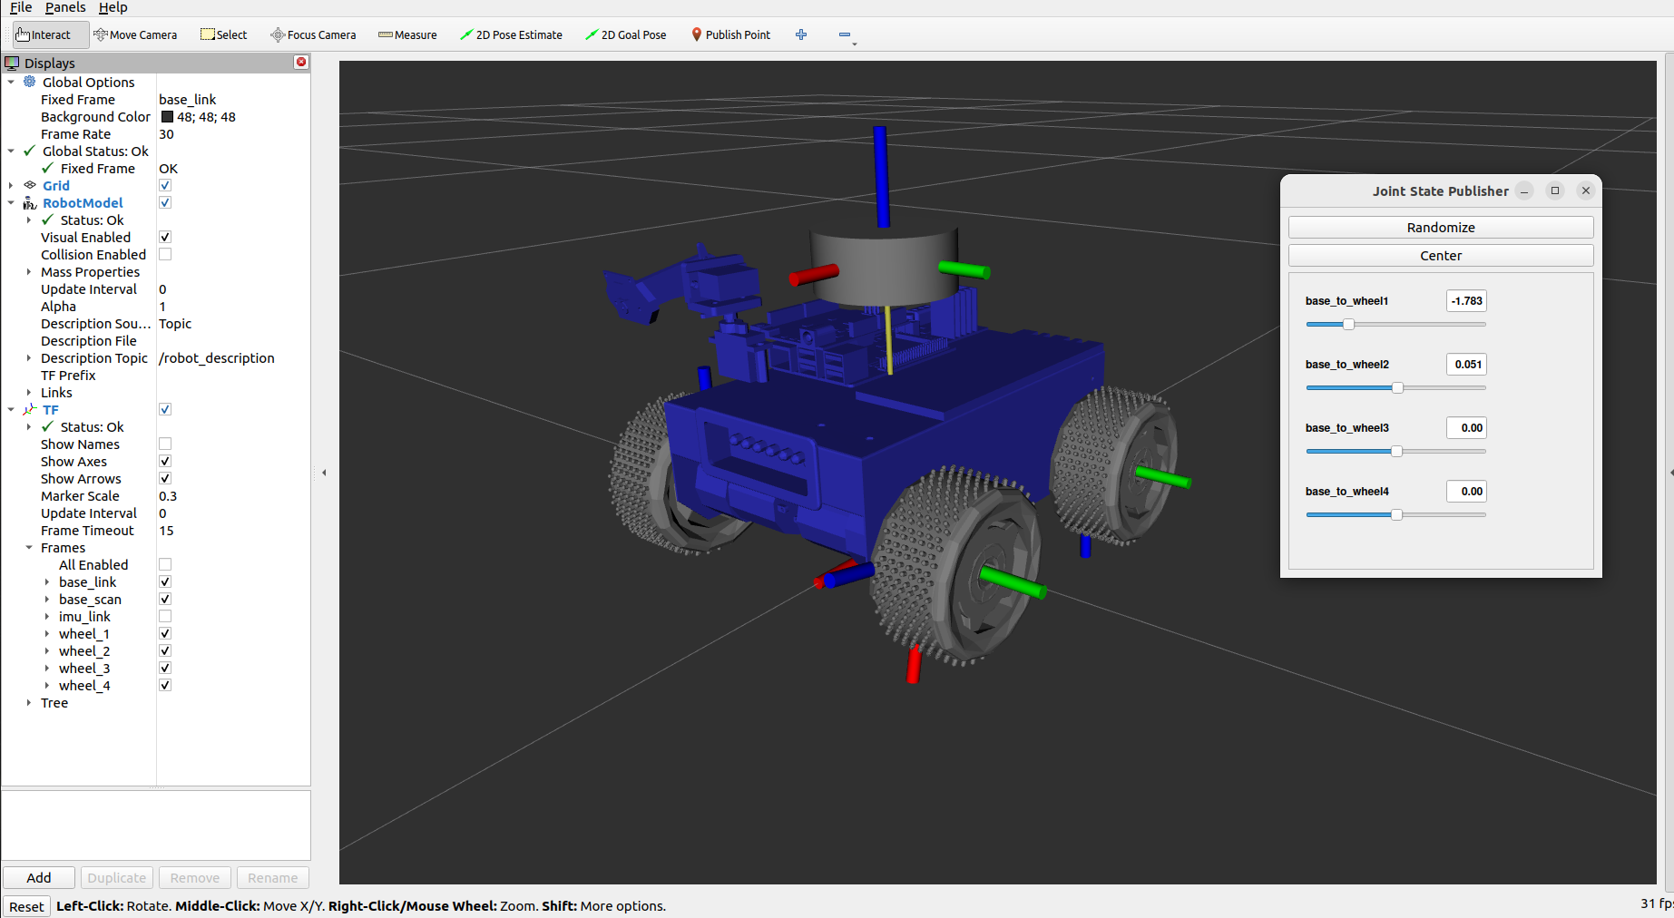
Example: ROS2 Network with Multiple Computers
/odometry
/rviz2
/bring_up
Microcontroller
/teleop
Nvidia Jetson
/cmd_vel
Laptop
ros2 run turtlesim turtlesim_node
ros2 run turtlesim turtle_teleop_key
Notes:
This slide connects turtlesim to a real robot.
A real mobile robot may have:
Microcontroller for motors Jetson or Raspberry Pi for onboard computation Laptop for teleoperation and RViz
The laptop may publish:
/cmd_vel
The robot may publish:
/odometry
RViz subscribes to data and visualizes it.
The important idea:
ROS2 is not limited to one program or one computer. It can connect multiple nodes across machines.
This is useful for mobile robots, multi-robot systems, and lab experiments.

Slide 45
ROS2 Package
scripts
executable node
executable node
executable node
config
parameters
configuration files
parameters
model
urdf
sdf
texture
launch
launch file
launch file
launch file
package.xml
Notes:
Now move from communication to code organization.
A ROS2 package is a folder that organizes code and files for a specific task.
A package may contain:
scripts = executable nodes config = parameter files model = URDF/SDF robot models launch = launch files package.xml = metadata and dependencies
Packages help keep ROS2 projects organized.

Slide 46
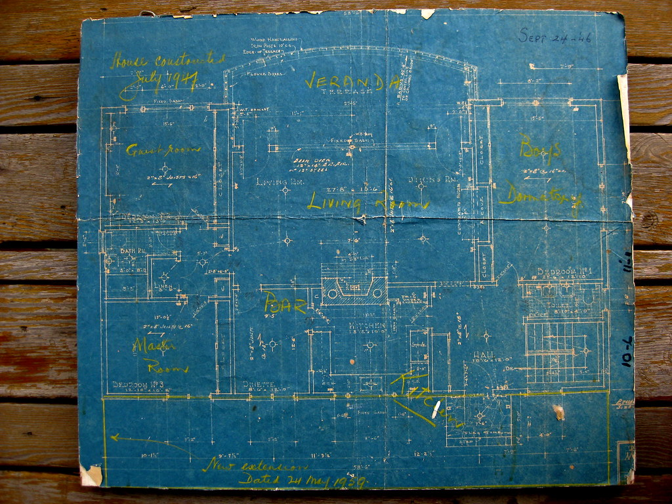
The concept of Package
For ROS2 Training with Pi
[pkg]
Package is a collection of organized files in a form of directory, which will used to "synthesize" nodes, launch system, etc. (usually for a specific task)
An anology of a package would be a folder where we can keep all blue prints of a house but not the house itself.
Introduction to ROS2
Notes:
Use the house blueprint analogy from the slide.
A package is not the running robot itself. It is like the folder containing the blueprints and materials needed to build or run part of the system.
For example, a package called turtlesim_control may contain:
a circle controller node a go-to-goal controller node launch files configuration files
The package groups related files together.

Slide 47
Source folder (src)
For ROS2 Training with Pi
src
sensor_calibration
ros_to_uart
trajectory_generator
"src" directory is where we put all custom packages together.
A package can be put inside another folder, which can be referred as a meta-package.
Introduction to ROS2
Notes:
In a ROS2 workspace, custom packages are placed inside the src folder.
Example:
me640_ws/ src/ turtlesim_control/ robot_description/ navigation_config/
The src folder is where we edit and develop our packages.
Mention:
Do not put random files everywhere. ROS2 expects packages to be organized inside the workspace source folder.

Slide 48
The concept of Workspace
For ROS2 Training with Pi
[workspace]
src
[ROS2] workspace is where we put every custom packages for a project.
Introduction to ROS2
Notes:
A workspace is the project folder that contains custom ROS2 packages.
Example:
me640_ws
Inside it:
src/ build/ install/ log/
At the beginning, only src exists. After building, ROS2 creates build, install, and log.
The workspace lets us keep all packages for one project together.

Slide 49
Build System
For ROS2 Training with Pi
[workspace]
[workspace]
colcon build
src
src
build
install
log
"colcon build" command will build every packages in the source directory and generate 3 additional directories. When modify "src", always re-build these 3 directories. (with an exception of using symlink install)
Introduction to ROS2
Notes:
Explain colcon build.
When we write code in src, ROS2 does not automatically know about the changes. We need to build the workspace.
Command:
colcon build
This creates:
build/ install/ log/
Important:
src = source code we edit install = built version ROS2 actually runs
That is why we rebuild after changing code.

Slide 50
Build System
For ROS2 Training with Pi
You must not create workspace inside another workspace
[workspace]
[workspace]
colcon build
src
src
build
install
log
"Install" directory is the location of codes that will be used by the ROS2 system. Therefore, only modifying "src" will not change the behavior of your system in run time.
Introduction to ROS2
Notes:
ROS2 usually runs code from the install directory. So changing a Python file in src may not affect runtime unless we rebuild or use --symlink-install.
Command:
colcon build --symlink-install
This is useful for Python because edits are reflected more easily.
Also emphasize:
Do not create a workspace inside another workspace.
Nested workspaces can cause confusing build and sourcing problems.

Slide 51
Creating a new workspace
For ROS2 Training with Pi
Create and build a new workspace
Adding workspace to .bashrc
>> mkdir –p ~/[xxx]_ws/src >> cd ~/[xxx]_ws >> colcon build
source ~/[xxx]_ws/install/local_setup.bash
Introduction to ROS2
Notes:
Now create the workspace.
Use:
mkdir -p ~/me640_ws/src cd ~/me640_ws colcon build source install/setup.bash
Explain each command:
mkdir -p creates the workspace and src folder. cd moves into the workspace. colcon build builds the workspace. source install/setup.bash tells the terminal about this workspace.
Optional:
echo "source ~/me640_ws/install/setup.bash" >> ~/.bashrc
This automatically sources the workspace in new terminals.

Slide 52
Package Layout
For ROS2 Training with Pi
src
include
C++ Headers
CMakeLists.txt
C++ code
CMake
test
doc
README
Test data
.doc/.pdf
[pkg]
config
Setting Parameters
launch
package.xml
Launch file
Package Identifier
[pkg_name]
setup.py*
LICENSE
py code
https://automaticaddison.com/organizing-files-and-folders-inside-a-ros-2-package/
Introduction to ROS2
Notes:
For Python packages, important files/folders include:
package.xml setup.py package_name/ launch/ config/
For C++ packages, you may also see:
src/ include/ CMakeLists.txt
Explain:
package.xml = dependency and metadata information setup.py = Python package installation settings launch = files to start multiple nodes config = parameter files
Students do not need to memorize everything now. They just need to recognize the package structure.

Slide 53
Creating a ROS Package
For ROS2 Training with Pi
>> cd ~/[xxx]_ws/src >> ros2 pkg create --build-type ament_python [package_name]
Package with Python
>> cd ~/[xxx]_ws/src >> ros2 pkg create --build-type ament_cmake [package_name]
Package with C++
The package that we create must be in the src directory of our workspace.
WCreating a ROS Packagehat if we have both C++ and Python files ?
Introduction to ROS2
Notes:
Now create a Python package.
Use:
cd ~/me640_ws/src ros2 pkg create --build-type ament_python turtlesim_control --dependencies rclpy geometry_msgs turtlesim
Explain:
ros2 pkg create = create new package --build-type ament_python = Python package turtlesim_control = package name --dependencies = packages this code needs
Then build:
cd ~/me640_ws colcon build --packages-select turtlesim_control --symlink-install source install/setup.bash

Slide 54
Creating my_first_pkg
For ROS2 Training with Pi
>> cd ~/[xxx]_ws/src >> ros2 pkg create --build-type ament_python my_first_pkg >> cd .. >> colcon build --packages-select my_first_pkg >> cd src/my_first_pkg >> code package.xml
>> cd my_first_pkg >> code my_first_script.py
https://ocs.ros.org/en/diamondback/api/licenses.html
Introduction to ROS2
Notes:
This slide shows the general workflow.
For our session, we can use turtlesim_control instead of my_first_pkg.
General steps:
1. Go to workspace src folder. 2. Create package. 3. Build package. 4. Edit package files. 5. Build again. 6. Source workspace. 7. Run node.
Mention:
In ROS2, most mistakes happen because we forget to build or forget to source the workspace.

Slide 55
Node class in ROS Client Library for Python (RCLPY)
For ROS2 Training with Pi
rclpy.node.Node
rclpy.pusblisher.Publisher
Subscriber callback
Timer_callback
Service server callback
publishers
subscriptions
timers
services
clients
executor
topic_name
publish
create_publisher
create_subscription
create_timer
create_service
create_client
get_clock
get_logger
get_name
rclpy.client.Client
-
call
call_async
remove_pending_request
service_is_ready
wait_for_service
Introduction to ROS2
Notes:
RCLPY is the ROS2 Python client library.
A Python node can create:
publishers subscriptions timers services clients
Important methods:
create_publisher() create_subscription() create_timer() create_service() create_client() get_logger()
Explain:
A ROS2 node is not just a normal Python script. It is a Python process connected to the ROS2 communication system.

Slide 56
General procedure on "running" a node using RCLPY
For ROS2 Training with Pi
Initialize rclpy using 'rclpy.init'
Instantiate a "Node" object
Spin node using rclpy.spin or spin once in a while-loop
If the processs exits the loop, de-construct the node
Shut down rclpy using rclpy.shutdown
Introduction to ROS2
Notes:
Every RCLPY node follows a standard structure.
Steps:
1. Initialize ROS2 Python with rclpy.init() 2. Create a node object 3. Spin the node 4. Destroy the node 5. Shut down rclpy
Explain spin:
Spinning means keeping the node alive so it can process timers, subscriptions, services, and callbacks.
Without spinning, the node would start and immediately exit.

Slide 57
Inheriting a Node class from RCLPY
For ROS2 Training with Pi
Import the superclass "Node"
from rclpy.node import Node
class NewNode(Node):
def __init__(self):
super().__init__('node_name')
def main(args=None):
rclpy.init(args=args)
node = NewNode()
rclpy.spin(node)
node.destroy_node()
rclpy.shutdown()
"NewNode" inherits from "Node"
Running a node of class "NewNode"
Introduction to ROS2
Notes:
Most ROS2 Python nodes are written as classes.
Correct import:
from rclpy.node import Node
The class inherits from Node:
class NewNode(Node):
Inside the constructor:
super().__init__('node_name')
This gives the ROS2 node its name.
Then:
rclpy.spin(node)
keeps the node running.
Explain:
We use class-based programming because the node often needs to remember internal variables, publishers, subscribers, and timers.

Slide 58
Attaching a timer to the node
For ROS2 Training with Pi
class NewNode(Node):
def __init__(self):
super().__init__('node_name')
self.timer = self.create_timer(1.0,timer_callback)
def timer_callback():
print('Hello World')
Period of the timer
Attaching the callback
Defining callback as a function
Introduction to ROS2
Notes:
A timer runs a callback repeatedly.
Example:
self.create_timer(1.0, timer_callback)
means call timer_callback every 1 second.
A timer is useful when we want a node to do something periodically, such as:
publish velocity at 10 Hz check sensor state update controller output print diagnostic information
For control, we usually use a timer because controllers run repeatedly.

Slide 59
Attaching a timer to the node
For ROS2 Training with Pi
class NewNode(Node):
def __init__(self):
super().__init__('node_name')
self.count = 0
self.timer = self.create_timer(1.0,self.timer_callback)
def timer_callback(self):
print(self.count)
self.count = self.count + 1
Defining new attribute
Make a value persist by accessing the attribuate of the instance
Defining callback as a method of the class
Introduction to ROS2
Notes:
This slide improves the previous one.
Instead of using an external function, we define the callback as a method of the class:
self.timer_callback
This is useful because the callback can access internal variables such as:
self.count
Explain:
If we want a value to persist between callback calls, we store it as an attribute of the object using self.
Example:
self.count = self.count + 1
The value is remembered each time the timer runs.

Slide 60
Attaching a publisher and publishing a message in a timer
For ROS2 Training with Pi
from std_msgs.msg import Int32
class NewNode(Node):
def __init__(self):
super().__init__('node_name')
self.count = 0
self.timer = self.create_timer(1.0,self.timer_callback)
self.pub = self.create_publisher(Int32,'output',10)
def timer_callback(self):
self.count = self.count + 1
msg = Int32()
msg.data = self.count
self.pub.publish(msg)
Import type of message
create a publisher
Instantiate a new message
publish a message
Introduction to ROS2
Notes:
This slide shows the basic pattern for publishing messages.
Correct import should be:
from std_msgs.msg import Int32
Steps:
1. Create a publisher. 2. Create a timer. 3. In the timer callback, create a message. 4. Fill the message data. 5. Publish the message.
Explain:
self.create_publisher(Int32, 'output', 10)
means create a publisher that sends Int32 messages on the topic called output.
The 10 is the queue size. For beginners, say it controls how many messages can be buffered.

Slide 61
Code for Exercise : drive turtle in a circle
Create this file:
cd ~/me640_ws/src/turtlesim_control/turtlesim_control code circle_controller.py
Paste:
Now edit setup.py:
cd ~/me640_ws/src/turtlesim_control code setup.py
Find entry_points and add:
entry_points={ 'console_scripts': [ 'circle_controller = turtlesim_control.circle_controller:main', ], },
Build and run:
cd ~/me640_ws colcon build --packages-select turtlesim_control --symlink-install source install/setup.bash
Terminal 1:
ros2 run turtlesim turtlesim_node
Terminal 2:
ros2 run turtlesim_control circle_controller
#!/usr/bin/env python3 import rclpy from rclpy.node import Node from geometry_msgs.msg import Twist class CircleController(Node): def __init__(self): super().__init__('circle_controller') self.pub = self.create_publisher( Twist, '/turtle1/cmd_vel',10 ) self.timer = self.create_timer(0.1, self.timer_callback) self.get_logger().info('Circle controller node has started.') def timer_callback(self): msg = Twist() msg.linear.x = 2.0 msg.angular.z = 1.0 self.pub.publish(msg) def main(args=None): rclpy.init(args=args) node = CircleController() rclpy.spin(node) node.destroy_node() rclpy.shutdown() if __name__ == '__main__': main()

Slide 62
Code for Exercise : turtle2 follow turtle1
Terminal 1: Start turtlesim
ros2 run turtlesim turtlesim_node
Terminal 2: Spawn turtle2
ros2 service call /spawn turtlesim/srv/Spawn "{x: 2.0, y: 2.0, theta: 0.0, name: 'turtle2'}"
Terminal 3: Control turtle1 using keyboard
ros2 run turtlesim turtle_teleop_key
Keep this terminal active when using the arrow keys.
Terminal 4: Run follower node
ros2 run turtlesim_controller turtle_follower
Inside entry_points, add:
'turtle_follower = turtlesim_controller.turtle_follower:main',
So, it may look like this:
entry_points={ 'console_scripts': [ 'turtle_follower = turtlesim_controller.turtle_follower:main', ], },
Build and source
cd ~/workspace_name colcon build --packages-select turtlesim_controller --symlink-install source install/setup.bash

Slide 63
Links
Github: https://github.com/tchoopojcharoen/simple_exercise/tree/rclpy_tutorial
Slides:
https://github.com/tchoopojcharoen/ROS2_pi_uwaterloo/blob/main/ROS2_pi_01.pdf
https://docs.google.com/presentation/d/1ljf_5OKg6Fc9qIX2WaIG2sxCiyDxQGLgppOHNE3uEas/edit?slide=id.p…

